Slide 1
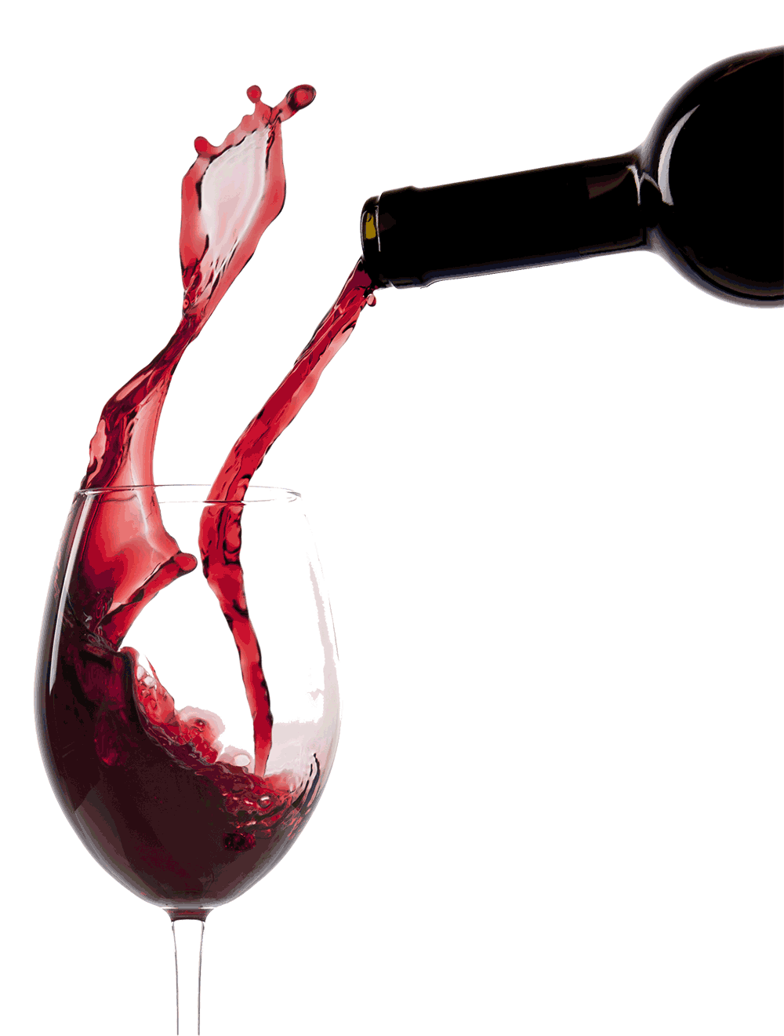
Wine Recognition
Presented by: Lucas |Fredrick |Ankit

Slide 2
Introduction
Wine can be classified in many methods. Which include: appellation, vintage, sweetness, style, etc.
Which method to be used may vary from one region to another or one country to another.
The most famous and used classifications include:
Bordeaux Wine Official classification of 1855,
German Wine classification system,
Classification of Saint-Emilion Wine,
Cru Bourgeois of Bordeaux
Predicting particular wine coming from which of three cultivars
(all three types are grown in same region of Italy)

Slide 3
Tools Used
We have used Python language with the help of well known packages, such as Seaborn, Numpy, Pandas, and Sci-Kit Learn.

Slide 4
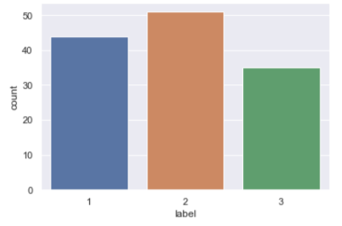
Methodology
All techniques that we used in this project are considered as EDA (Exploratory Data Analysis) or Machine Learning Classification Algorithm.
First of all we checked for the number of labels (Cultivars) for each of the wines to check if there is considerable difference .
As seen in figure the number of labels for cultivars 1, 2, and 3 were 44, 51 and 35 respectively.

Slide 5
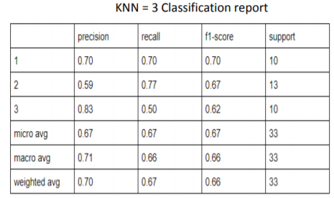
Methodology
After trying K Nearest Neighbors (using K= 1, 3, 5) with a low accuracies, we decided to transform the data with Box-Cox transformation.
The method chosen was Box-Cox transformation because it is known to transform non-normal dependent variables into normal shape.
After the transformation, the accuracy of the prediction increased by more than 20%.

Slide 6
Methodology
We also used new training techniques, such as
Logistic Regression
MLP (Multi Layer Perceptron using 1 and 2 layers)
Gaussian Naive Bayes
Random Forest.
Some attempts were done using all the features, and some with the help of feature selection techniques.
Notes:
Features selection techniques like Fishers’ indexes, data analysis and Random Forest algorithm.

Slide 7
Data
The data-set wineTrain consists of 178 observations.
We had the information of which cultivar the sample belongs for 130 of these observation.
Another 48 observation, we need to predict for it.
wineTrainX, with samples and features (13x130)
wineTrainY, with respective labels (1x130)
wineTestX, (13x48), there were no labels for these observations.

Slide 8
Data
The following 13 features that we needed to analyze:
Alcohol, Malic acid, Ash, Alcalinity of ash, Magnesium, Total phenols, Flavanoids, Non-flavanoid phenols, Proanthocyanins, Color intensity, Hue, OD280/OD315 of diluted wines, Proline.

Slide 9
Data
The following 13 samples that we needed to analyze:
Alcohol, Malic acid, Ash, Alcalinity of ash, Magnesium, Total phenols, Flavanoids, Nonflavanoid phenols, Proanthocyanins, Color intensity, Hue, OD280/OD315 of diluted wines, Proline.

Slide 10
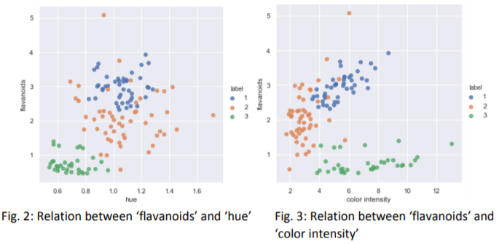
Data
With the help of Seaborn Library we created pair plots for all the possible relations between features.
We verified that some of the them were good features and relations for classifying some labels:
Notes:
we can clearly see that label 3 can be separated and flavanoids can be considered an important feature with respect to classification.

Slide 11
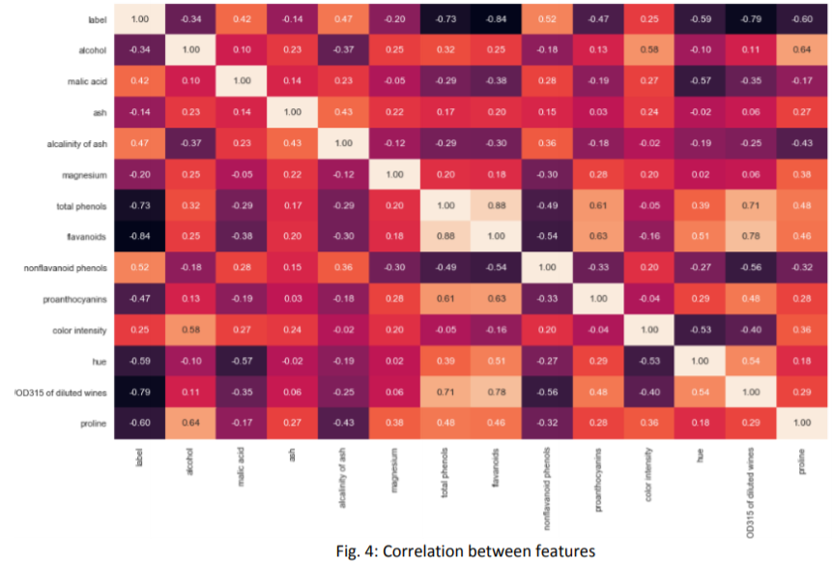
Data
Notes:
We also checked how correlated features were, because features that have a high correlation may interfere in some classification methods.
we can verify that ‘flavanoids’ and ‘total phenols’ are very correlated.
Its interesting to remove vary corelated features because it makes the model simpler and it can optimized some algorithms such as logistic regression which suffers from multicolinerality.

Slide 12
Data
After testing ‘total phenols’ and ‘flavanoids’ with box plots, it was found that ‘flavanoids’ was the best feature to keep in the models for its capacity of separating labels 1 and 3.
several tests were made with and without using ‘total phenols’ to verify if improvements were achieved.
Figure shows exactly how flavanoids and total phenols are distributed in the samples

Slide 13
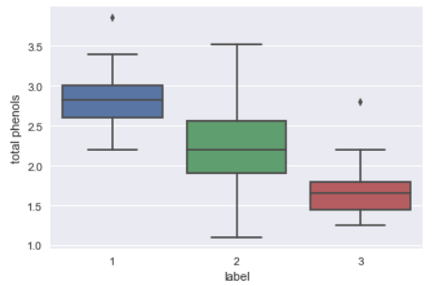
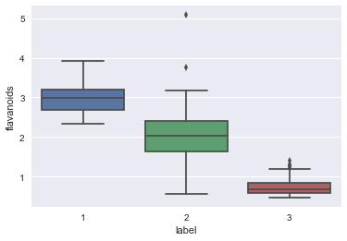
Data

Slide 14
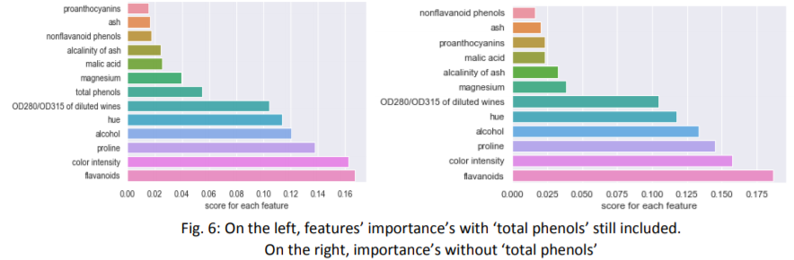
Data
We also verified feature importance’s/scores from the dataset through Sklearn’s Random Forest function called “feature_importances”
Notes:
the removal of ‘total phenols’ did not change the importance order of the remaining features.
Also, the disparity between the first six features and the last six features increased.

Slide 15
Result
In beginning, with an attempt of using K-Nearest-Neighbours, accuracy with KNN = 3 was 69% and 66% with KNN =5.
So, we transformed our data with Sklearn’s Power transform function, which utilized the ‘Box-Cox’ method.
Models were compared through 5-fold cross validations. We did not use higher than 5 because it would result in relatively small testing groups.
Every model was tested with and without ‘total phenols’ and with the Random Forest’s aforementioned Feature Importances function as well.
From the Feature Importances function, we considered the six features with the highest scores

Slide 16
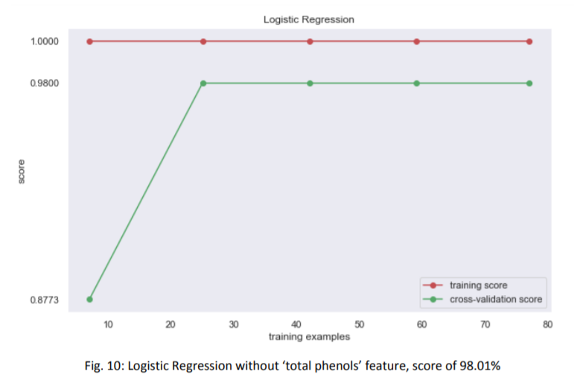
Result

Slide 17
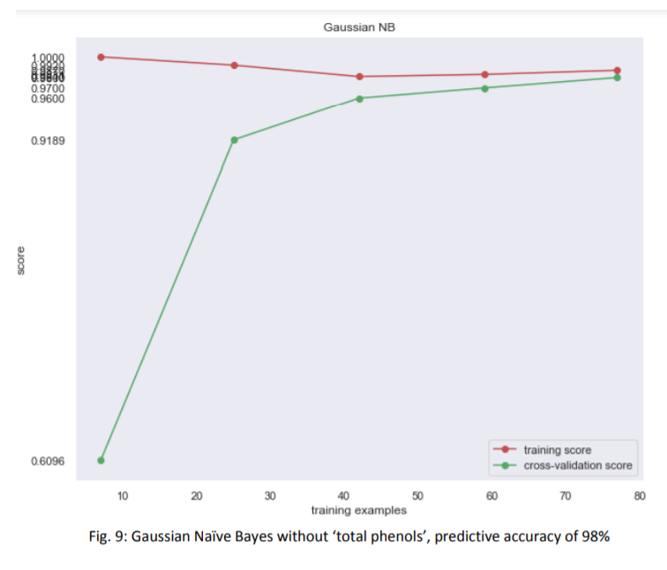
Result

Slide 18
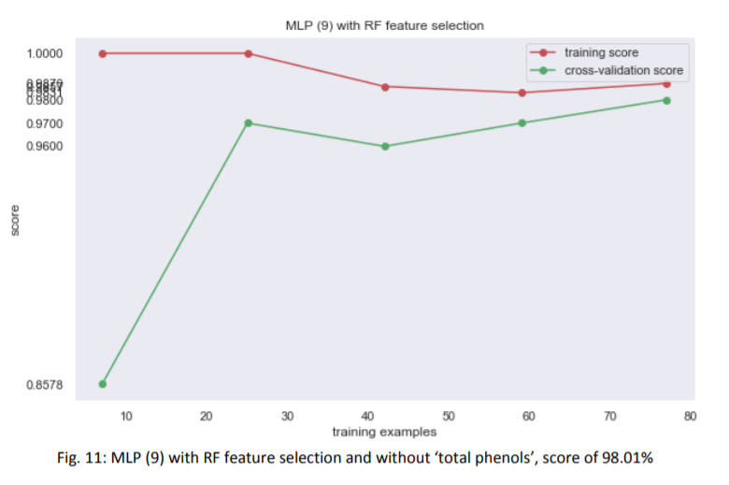
Result

Slide 19
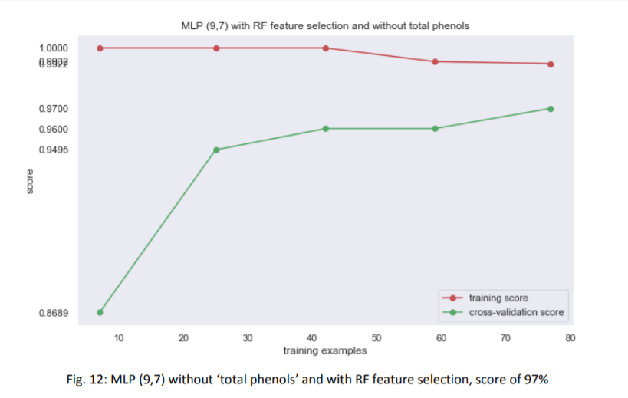
Result

Slide 20
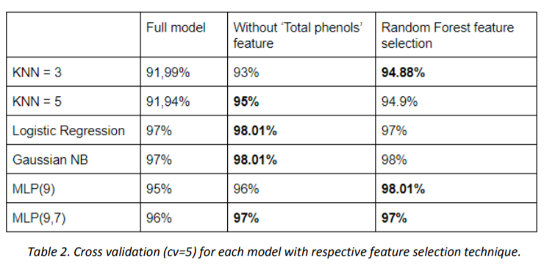
Result

Slide 21
Conclusion
It was a very simple classification problem, with low number of features, labels and samples.
None of the models tested managed to achieve more than 98.01% accuracy.
Which indicate that some samples weren’t fit for classification algorithms, being nearly impossible to classify accordingly.
More tests could be done with a higher number of samples in order to further verify and increase the models’ predictive power, especially Multi-layer Perceptron.

Slide 22
Thank You
Questions?

Slide 23
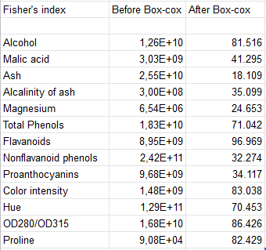

Slide 24
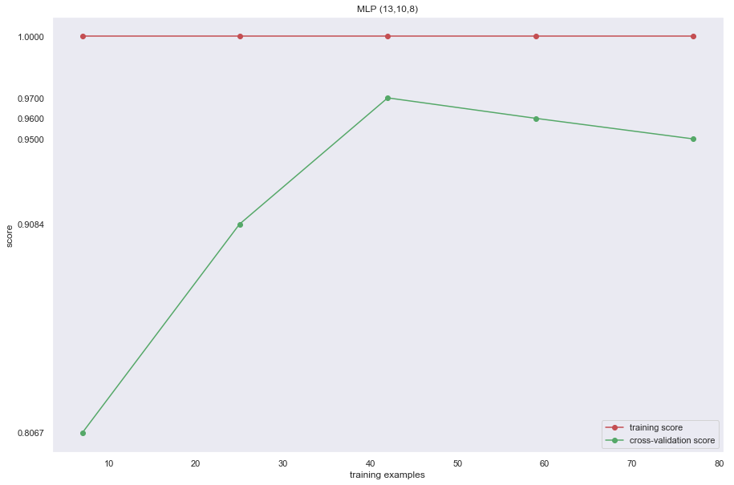

Slide 25
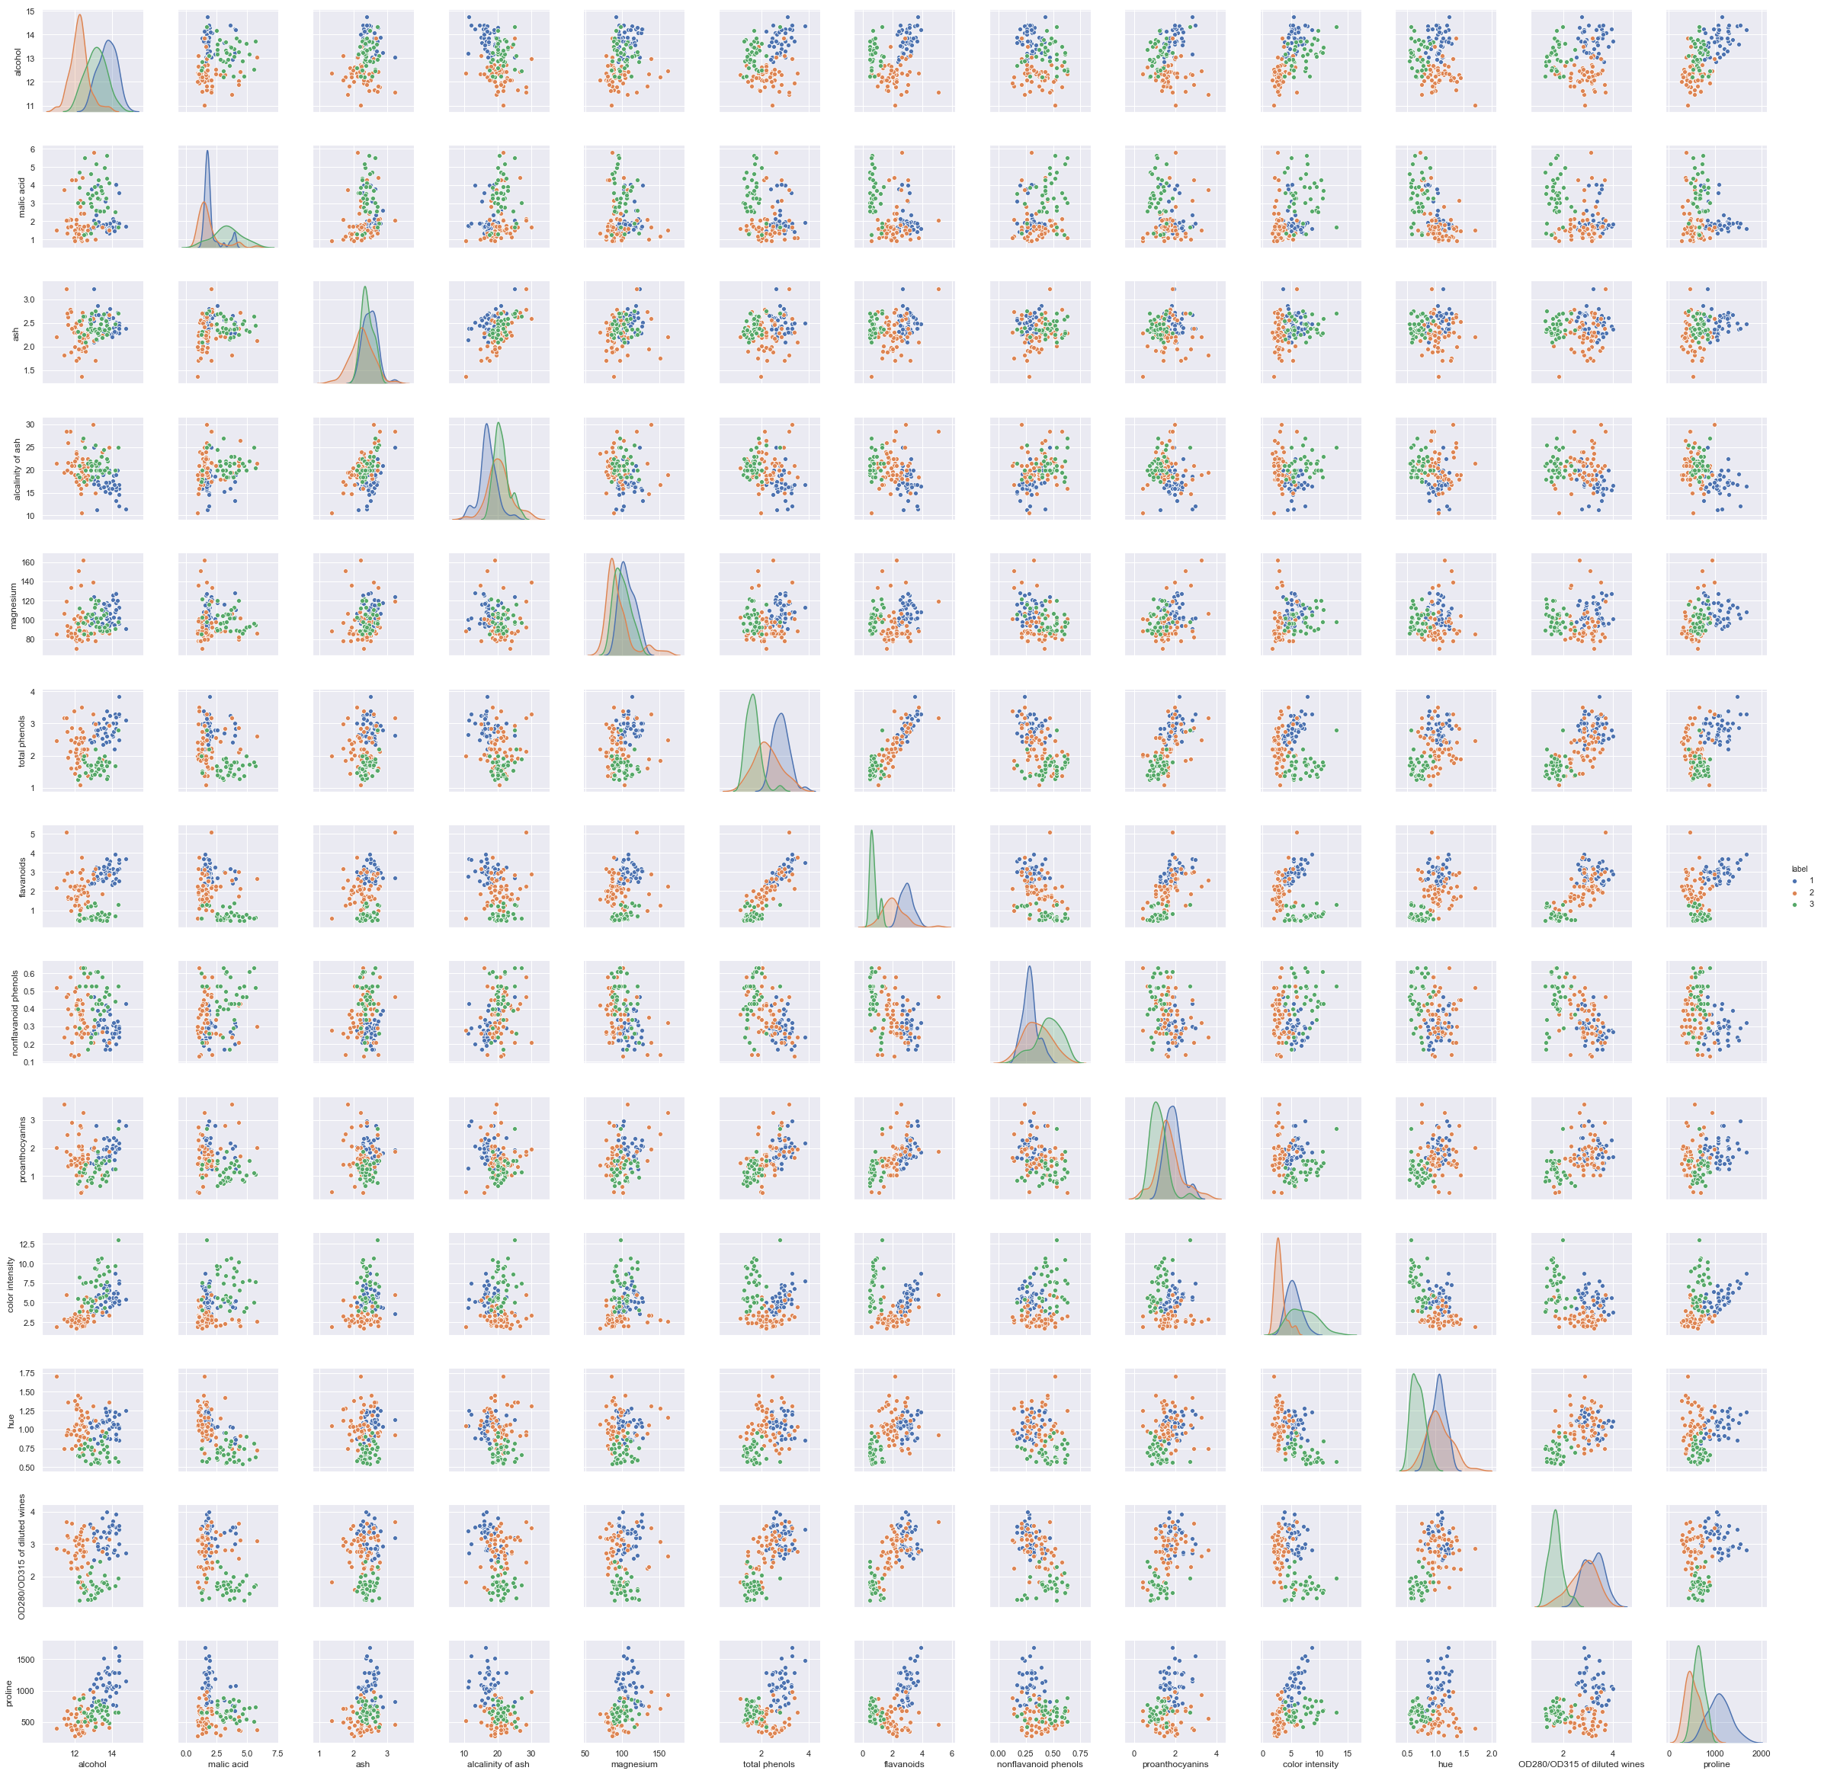

Slide 26
